Slide 1

Data Communication and Networking (DCAN 202)
Week 10
Kent Institute Australia Pty. Ltd.
ABN 49 003 577 302 CRICOS Code: 00161E RTO Code: 90458 TEQSA Provider Number: PRV12051
Version 2 – 18th December 2015

Slide 2
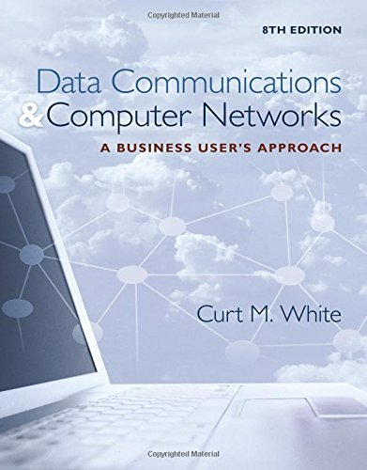
Chapter 5: Making Connections Efficient: Multiplexing and Compression
Data Communications and Computer Networks: A Business User's Approach, Eighth Edition
© 2016. Cengage Learning. All right reserved.

Slide 3
Todays Lecture
Frequency division multiplexing Vs Synchronous time division multiplexing
Multiplexing characteristics of T-1 and SONET/SDH systems
Statistical time division multiplexing
Wavelength division multiplexing
Characteristics of discrete multitone
Characteristics of code division multiplexing
Apply a multiplexing technique to a typical business situation
Difference between lossy and lossless compression
Basic operation of run-length, JPEG, and MP3 compression
Applications, advantages, and disadvantages of various multiplexing techniques

Slide 4
Introduction
Under simplest conditions, medium can carry only one signal at any moment in time
For multiple signals to share a medium, medium must somehow be divided, giving each signal a portion of the total bandwidth
Current techniques include:
Frequency division multiplexing
Time division multiplexing
Code division multiplexing

Slide 5
Frequency Division Multiplexing
Assignment of non-overlapping frequency ranges to each “user” or signal on a medium
Thus, all signals are transmitted at the same time, each using different frequencies
A multiplexor accepts inputs and assigns frequencies to each device

Slide 6
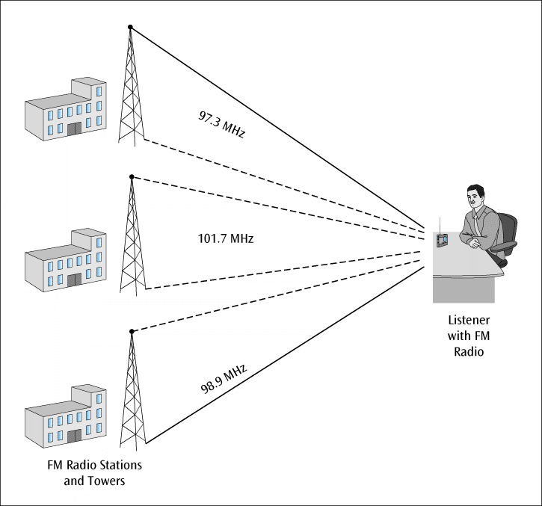
Frequency Division Multiplexing
Each channel is assigned a set of frequencies and is transmitted over the medium
A corresponding multiplexor, or demultiplexor, is on the receiving end of the medium and separates the multiplexed signals
A common example is broadcast radio
Source: Data Communications and Computer Networks: A Business User's Approach, Eighth Edition
© 2016. Cengage Learning. All right reserved.
Simplified example of frequency division multiplexing

Slide 7
Frequency Division Multiplexing
Analog signaling is used in older systems; discrete analog signals in more recent systems
Broadcast radio and television, cable television, and cellular telephone systems use frequency division multiplexing
This technique is the oldest multiplexing technique
Since it involves a certain level of analog signaling, it may be susceptible to noise

Slide 8
Time Division Multiplexing
Sharing of the signal is accomplished by dividing available transmission time on a medium among users
Digital signaling is used exclusively
Time division multiplexing comes in two basic forms:
Synchronous time division multiplexing
Statistical time division multiplexing

Slide 9
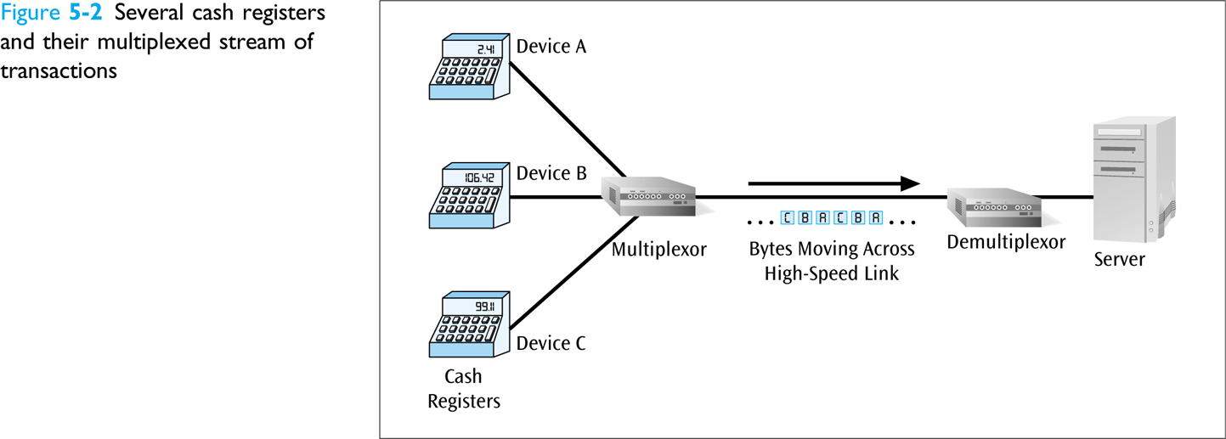
Synchronous Time Division Multiplexing
The original time division multiplexing
The multiplexor accepts input from attached devices in a round-robin fashion and transmits the data in a never -ending pattern
T-1 and SONET telephone systems are common examples of synchronous time division multiplexing
Source: Data Communications and Computer Networks: A Business User's Approach, Eighth Edition
© 2016. Cengage Learning. All right reserved.
Several cash registers and their multiplexed stream of transactions

Slide 10
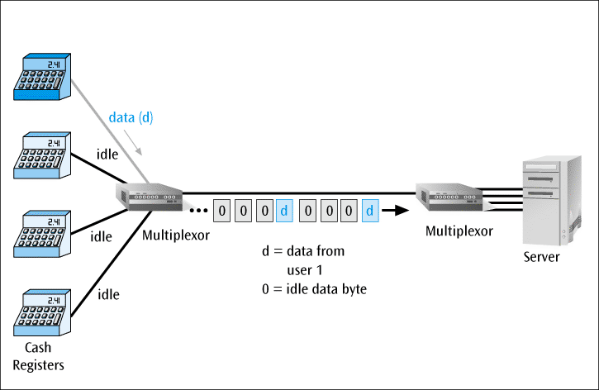
Synchronous Time Division Multiplexing
If one device generates data at faster rate than other devices, then the multiplexor must either sample the incoming data stream from that device more often than it samples the other devices, or buffer the faster incoming stream
If a device has nothing to transmit, the multiplexor must still insert something into the multiplexed stream
Source: Data Communications and Computer Networks: A Business User's Approach, Eighth Edition
© 2016. Cengage Learning. All right reserved.
Multiplexor transmission stream with only one input device transmitting data

Slide 11
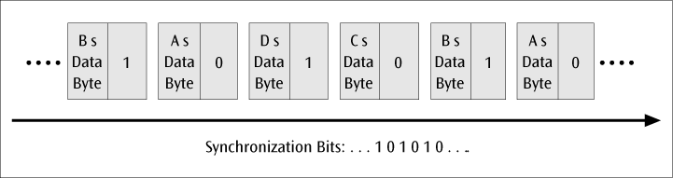
Synchronous Time Division Multiplexing
For the receiver to stay synchronized with the incoming data stream, the transmitting multiplexor can insert alternating 1s and 0s into the data stream
Transmitted frame with added synchronization bits

Slide 12
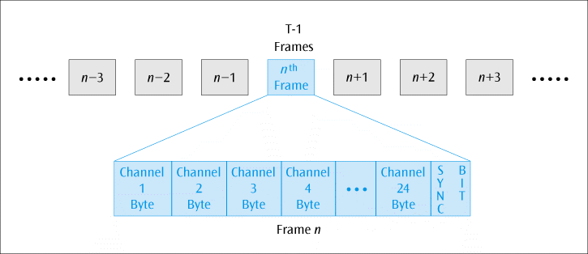
T-1 Multiplexing
The T-1 multiplexor stream is a continuous series of frames
Note how each frame contains the data (one byte) for potentially 24 voice-grade telephone lines, plus one sync bit
It is possible to combine all 24 channels into one channel for a total of 1.544 Mbps
Source: Data Communications and Computer Networks: A Business User's Approach, Eighth Edition
© 2016. Cengage Learning. All right reserved.
T-1 multiplexed data stream

Slide 13
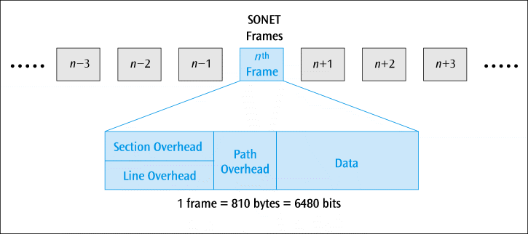
SONET/SDH Multiplexing
Similar to T-1, SONET incorporates a continuous series of frames
SONET is used for high-speed data transmission
Telephone companies have traditionally used a lot of SONET but this may be giving way to other high-speed transmission services
SDH is the European equivalent to SONET
Source: Data Communications and Computer Networks: A Business User's Approach, Eighth Edition
© 2016. Cengage Learning. All right reserved.
SONET STS-1 frame layout

Slide 14
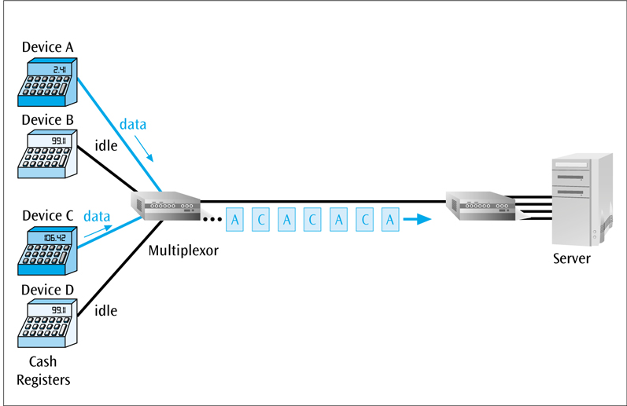
Statistical Time Division Multiplexing
A statistical multiplexor transmits the data from active workstations only
If a workstation is not active, no space is wasted in the multiplexed stream
Source: Data Communications and Computer Networks: A Business User's Approach, Eighth Edition
© 2016. Cengage Learning. All right reserved.
Two stations out of four transmitting via a statistical multiplexor

Slide 15
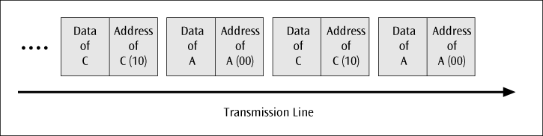
Statistical Time Division Multiplexing
A statistical multiplexor accepts the incoming data streams and creates a frame containing the data to be transmitted
To identify each piece of data, an address is included
Sample address and data in a statistical multiplexor output stream

Slide 16
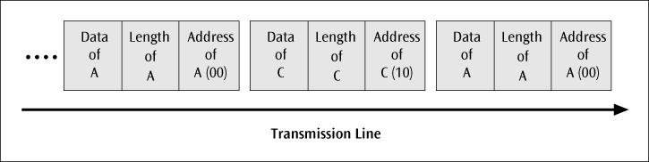
Statistical Time Division Multiplexing
If the data is of variable size, a length is also included
Packets of address, length, and data fields in a statistical multiplexor output stream

Slide 17
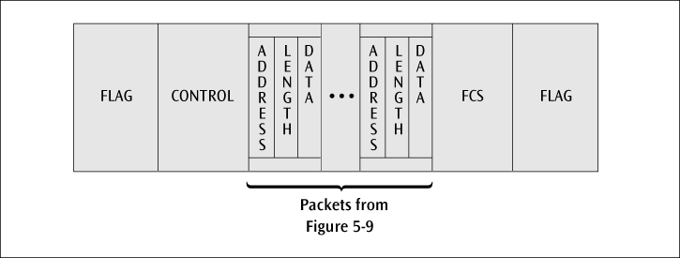
Statistical Time Division Multiplexing
More precisely, the transmitted frame contains a collection of data groups
Frame layout for the information packet transferred between statistical multiplexors

Slide 18
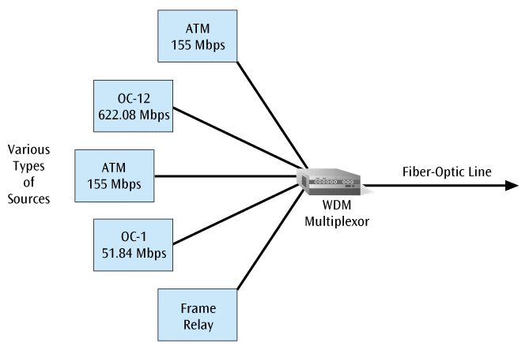
Wavelength Division Multiplexing (WDM)
WDM multiplexes multiple data streams onto a single fiber-optic line
Different wavelength lasers (called lambdas) transmit the multiple signals
Each signal carried on the fiber can be transmitted at a different rate from the other signals
Dense wavelength division multiplexing (DWDM) combines many (30, 40, 50 or more) onto one fiber
Coarse wavelength division multiplexing combines only a few lambdas
Source: Data Communications and Computer Networks: A Business User's Approach, Eighth Edition
© 2016. Cengage Learning. All right reserved.
Fiber optic line using wavelength division multiplexing and supporting multiple- speed transmissions

Slide 19
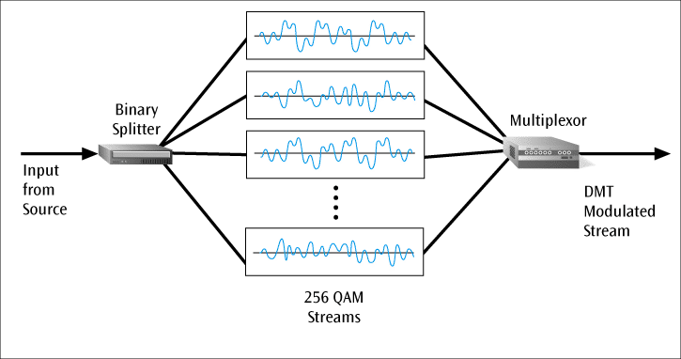
Discrete Multitone
Discrete Multitone (DMT) – a multiplexing technique commonly found in digital subscriber line (DSL) systems
DMT combines hundreds of different signals, or subchannels, into one stream
Interestingly, all of these subchannels belong to a single user, unlike the previous multiplexing techniques
Each subchannel is quadrature amplitude modulated (recall eight phase angles, four with double amplitudes)
Theoretically, 256 subchannels, each transmitting 60 kbps, yields 15.36 Mbps
Unfortunately, there is noise, so the subchannels back down to slower speeds
Source: Data Communications and Computer Networks: A Business User's Approach, Eighth Edition
© 2016. Cengage Learning. All right reserved.
256 quadrature amplitude modulated streams combined into one DMT signal for DSL

Slide 20
Code Division Multiplexing
Also known as code division multiple access (CDMA)
An advanced technique that allows multiple devices to transmit on the same frequencies at the same time
Each mobile device is assigned a unique 64-bit code

Slide 21
Code Division Multiplexing
To send a binary 1, a mobile device transmits the unique code
To send a binary 0, a mobile device transmits the inverse of the code
To send nothing, a mobile device transmits zeros
Receiver gets summed signal, multiplies it by receiver code, adds up the resulting values
Interprets as a binary 1 if sum is near +64
Interprets as a binary 0 if sum is near -64

Slide 22
Code Division Multiplexing
For simplicity, assume 8-bit code
Example
Three different mobile devices use the following codes:
Mobile A: 11110000
Mobile B: 10101010
Mobile C: 00110011
Assume Mobile A sends a 1, B sends a 0, and C sends a 1
Signal code: 1-chip = +N volt; 0-chip = -N volt

Slide 23
Code Division Multiplexing
Example (continued)
Three signals transmitted:
Mobile A sends a 1, or 11110000, or ++++----
Mobile B sends a 0, or 01010101, or -+-+-+-+
Mobile C sends a 1, or 00110011, or --++--++
Summed signal received by base station: -1, +1, +1, +3, -3, -1, -1, +1

Slide 24
Code Division Multiplexing
Example (continued)
Base station decode for Mobile A:
Signal received: -1, +1, +1, +3, -3, -1, -1, +1
Mobile A’s code: +1, +1, +1, +1, -1, -1, -1, -1
Product result: -1, +1, +1, +3, +3, +1, +1, -1
Sum of Products: +8
Decode rule: For result near +8, data is binary 1

Slide 25
Code Division Multiplexing
Example (continued)
Base station decode for Mobile B:
Signal received: -1, +1, +1, +3, -3, -1, -1, +1
Mobile B’s code: +1, -1, +1, -1, +1, -1, +1, -1
Product result: -1, -1, +1, -3, -3, +1, -1, -1
Sum of Products: -8
Decode rule: For result near -8, data is binary 0

Slide 26
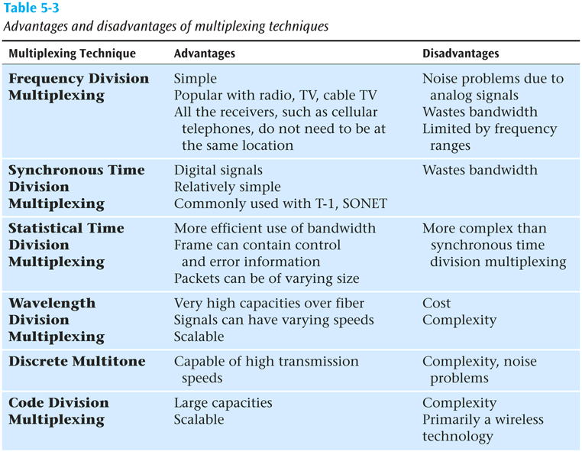
Comparison of Multiplexing Techniques
Source: Data Communications and Computer Networks: A Business User's Approach, Eighth Edition
© 2016. Cengage Learning. All right reserved.

Slide 27
Compression–Lossless versus Lossy
Compression is another technique used to squeeze more data over a communications line or into a storage space
If you can compress a data file down to one half of its original size, the file will obviously transfer in less time
Two basic groups of compression:
Lossless – when data is uncompressed, original data returns
Lossy – when data is uncompressed, you do not have the original data

Slide 28
Compression–Lossless versus Lossy
Compress a financial file?
You want lossless
Compress a video image, movie, or audio file?
Lossy is OK
Examples of lossless compression include:
Huffman codes, run-length compression, Lempel-Ziv compression, and FLAC
Examples of lossy compression include:
MPEG, JPEG, and MP3

Slide 29
Lossless Compression
Run-length encoding
Replaces runs of 0s with a count of how many 0s.
00000000000000100000000011000000000000000000001…11000000000001
^
(30 0s)
14 9 0 20 30 0 11

Slide 30
Lossless Compression
Run-length encoding (continued)
Now replace each decimal value with a 4-bit binary value (nibble)
Note: If you need to code a value larger than 15, you need to use two consecutive 4-bit nibbles
The first is decimal 15, or binary 1111, and the second nibble is the remainder
For example, if the decimal value is 20, you would code 1111 0101 which is equivalent to 15 + 5

Slide 31
Lossless Compression
Run-length encoding (continued)
If you want to code the value 15, you still need two nibbles: 1111 0000
The rule is that if you ever have a nibble of 1111, you must follow it with another nibble

Slide 32
Lossy Compression
Audio and video files do not compress well using lossless techniques
And we can take advantage of the fact that the human ear and eye can be tricked into hearing and seeing things that aren’t really there
So let’s use lossy compression techniques on audio and video (just as long as we don’t lose too much of the audio or video!)

Slide 33
Audio Compression
Much audio is now compressed - MP3 players found in cell phones and iPod-like devices store and play compressed music
Audio compression is tricky and hard to describe. For example, a louder sound may mask a softer sound when both played together (so drop the softer sound)
Some people don’t like compressed audio and prefer to store their music in uncompressed form (such as FLAC), but this takes more storage

Slide 34
Video Compression
Video (both still images and moving video) does not compress well using run-length encoding
When examining the pixel values in an image, not many are alike
But what about from frame to frame within a moving video?
The difference between video frames is usually very small
So what if we just sent the difference between frames?

Slide 35
Video Compression
5 7 6 2 8 6 6 3 5 6
6 5 7 5 5 6 3 2 4 7
8 4 6 8 5 6 4 8 8 5
5 1 2 9 8 6 5 5 6 6
First Frame
5 7 6 2 8 6 6 3 5 6
6 5 7 6 5 6 3 2 3 7
8 4 6 8 5 6 4 8 8 5
5 1 3 9 8 6 5 5 7 6
Second Frame
0 0 0 0 0 0 0 0 0 0
0 0 0 1 0 0 0 0 -1 0
0 0 0 0 0 0 0 0 0 0
0 0 1 0 0 0 0 0 1 0
Difference

Slide 36
MPEG
MPEG (Motion Picture Experts Group) is a group of people that have created a set of standards that can use these small differences between frames to compress a moving video (and audio) to a fraction of its original size

Slide 37
Image Compression
What about individual images?
For example, a color image can be defined by red/green/blue, or luminance/chrominance/ chrominance, which are based on RGB values (Red, Green, Blue)
If you have three color values and each is 8 bits, you have 24 bits total (or 224 colors!)
Consider a VGA screen is 640 x 480 pixels
24 bits x 640 x 480 = 7,372,800 bits – Ouch!
We need compression!

Slide 38
Image Compression - JPEG
JPEG (Joint Photographic Experts Group)
Compresses still images
Lossy
JPEG compression consists of 3 phases:
Discrete cosine transformations (DCT)
Quantization
Run-length encoding

Slide 39
Image Compression - JPEG
JPEG Step 1 – DCT
Divide image into a series of 8x8 pixel blocks
If the original image was 640x480 pixels, the new picture would be 80 blocks x 60 blocks (next slide)
If B&W, each pixel in 8x8 block is an 8-bit value (0-255)
If color, each pixel is a 24-bit value (8 bits for red, 8 bits for blue, and 8 bits for green)

Slide 40
Image Compression - JPEG
80 blocks
60 blocks
640 x 480 VGA Screen Image
Divided into 8 x 8 Pixel Blocks

Slide 41
Image Compression - JPEG
JPEG Step 1 – DCT (continued)
So what does DCT do?
Takes an 8x8 matrix (P) and produces a new 8x8 matrix (T) using cosines
T matrix contains a collection of values called spatial frequencies
These spatial frequencies relate directly to how much the pixel values change as a function of their positions in the block

Slide 42
Image Compression - JPEG
JPEG Step 1 – DCT (continued)
An image with uniform color changes (little fine detail) has a P matrix with closely similar values and a corresponding T matrix with many zero values
An image with large color changes over a small area (lots of fine detail) has a P matrix with widely changing values, and thus a T matrix with many non-zero values (as shown on next slide)

Slide 43
120 | 80 | 110 | 65 | 90 | 142 | 56 | 100
40 | 136 | 93 | 188 | 90 | 210 | 220 | 56
95 | 89 | 134 | 74 | 170 | 180 | 45 | 100
9 | 110 | 145 | 93 | 221 | 194 | 83 | 110
65 | 202 | 90 | 18 | 164 | 90 | 155 | 43
93 | 111 | 39 | 221 | 33 | 37 | 40 | 129
55 | 122 | 52 | 166 | 93 | 54 | 13 | 100
29 | 92 | 153 | 197 | 84 | 197 | 83 | 83
Original pixel
values (P matrix)
652 | 32 | -40 | 54 | -18 | 129 | -33 | 84
111 | -33 | 53 | 9 | 123 | -43 | 65 | 100
-22 | 101 | 94 | -32 | 23 | 104 | 76 | 101
88 | 33 | 211 | 2 | -32 | 143 | 43 | 14
132 | -32 | 43 | 0 | 122 | -48 | 54 | 110
54 | 11 | 133 | 27 | 56 | 154 | 13 | -94
-54 | -69 | 10 | 109 | 65 | 0 | 17 | -33
199 | -18 | 99 | 98 | 22 | -43 | 8 | 32
Values (T matrix)
after the cosine
transformation
has been
applied (note
larger values in
upper-left)

Slide 44
Image Compression - JPEG
JPEG Step 2 -Quantization
The human eye can’t see small differences in color
So take T matrix and divide all values by 10
Will give us more zero entries
More 0s means more compression!
But this is too lossy
And dividing all values by 10 doesn’t take into account that upper left of matrix has more weight
So divide T matrix by a matrix like the following:

Slide 45
Image Compression - JPEG
1 | 4 | 7 | 10 | 13 | 16 | 19 | 22
4 | 7 | 10 | 13 | 16 | 19 | 22 | 25
7 | 10 | 13 | 16 | 19 | 22 | 25 | 28
10 | 13 | 16 | 19 | 22 | 25 | 28 | 31
13 | 16 | 19 | 22 | 25 | 28 | 31 | 33
16 | 19 | 22 | 25 | 28 | 31 | 33 | 36
19 | 22 | 25 | 28 | 31 | 34 | 37 | 40
22 | 25 | 28 | 31 | 34 | 37 | 40 | 43
If we divide the T matrix by the above matrix,
we might get something like the next slide:

Slide 46
Image Compression - JPEG
652 | 8 | -5 | 5 | -1 | 8 | 0 | 3
27 | -4 | 5 | 0 | 7 | -2 | 2 | 4
-3 | 10 | 7 | 2 | 1 | 4 | 3 | 3
8 | 2 | 13 | 0 | -1 | 5 | 1 | 0
10 | -2 | 2 | 0 | 4 | -1 | 1 | 3
3 | 0 | 6 | 1 | 2 | 4 | 0 | -2
-2 | -3 | 0 | 3 | 2 | 0 | 0 | 0
9 | 0 | 3 | 3 | 0 | -1 | 0 | 0
The resulting matrix Q after cosine
transformation and quantization

Slide 47
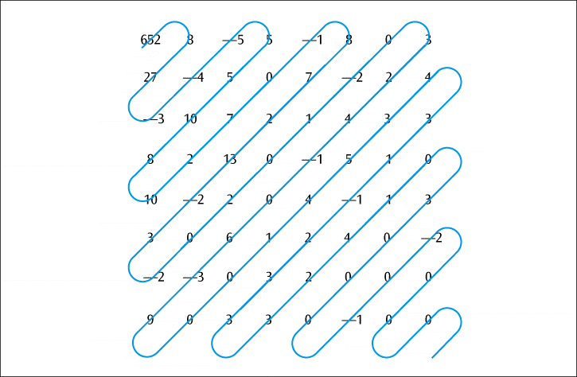
Image Compression - JPEG
JPEG Step 3 – Run-length encoding
Now take the quantized matrix Q and perform run-length encoding on it
But don’t just go across the rows
Longer runs of zeros if you perform the run-length encoding in a diagonal fashion
Run-length encoding of a JPEG image

Slide 48
Image Compression - JPEG
How do you get the image back?
Undo run-length encoding
Multiply matrix Q by matrix U yielding matrix T
Apply similar cosine calculations to get original P matrix back

Slide 49
Business Multiplexing In Action
Bill’s Market has 10 cash registers at the front of their store
Bill wants to connect all cash registers together to collect data transactions
List some efficient techniques to link the cash registers

Slide 50
Business Multiplexing In Action
Possible solutions
Connect each cash register to a server using point-to-point lines
Transmit the signal of each cash register to a server using wireless transmissions
Combine all the cash register outputs using multiplexing, and send the multiplexed signal over a conducted-medium line

Slide 51

kent.edu.au Kent Institute Australia Pty. Ltd. ABN 49 003 577 302 ● CRICOS Code: 00161E ● RTO Code: 90458 ● TEQSA Provider Number: PRV12051

